Slide 1
Team 3 – Final Report
Stair climbing wheel chair
TA | Nazhar Hussain
140100084 | P. Prudhvi
140100086 | Gulam Sarwar
140100096 | P. Sreeram Kumar Reddy
140100101 | P. Vachan Deep
140100108 | D. Prudhvi charan

Slide 2
Contents
Executive Summary
Presentation (presented for end term review)
Theoretical analysis
Product overall design
Prototype design iterations
Prototype part details

Slide 3
Executive summary
Abstract : There is a large segment of population having disability in movement and cannot access stairs due to the functionality limitations of wheelchairs in climbing and descending stairs. The existing stair climbing wheelchairs are not affordable due to their high costs. Our aim is to design a completely passive stair climbing wheelchair which will be powered by a companion and can climb stairs in the range of width (15-30cm) and height(up to 20 cm).We aim to reduce the cost upto 80%
Proof of concept: We have built a prototype to demonstrate the stair climbing mechanism .It can ascend stairs of width 15-25 cm and height upto 15cm

Slide 4
Main presentation

Slide 5
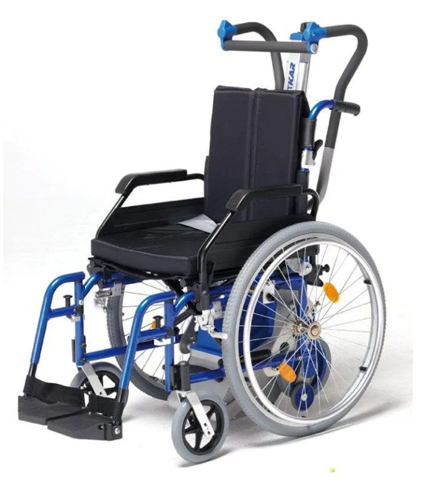
Motivation
About 54 lakh people have disability in movement (Census 2011)
Around 1.2 lakh wheel chair users among them (Financial express 6th Aug 2012)
Usage and availability of stair climbing wheel chairs in India is very low
Cost of the stair climbers currently available in market is more than 1.5 lakhs
We propose a solution to reduce this cost by 70%
Source

Slide 6
Goals
Climb and descend stairs
Be usable on ground
Work on varying stair geometries
Low cost
Smooth functioning
Single companion operable
Capacity ~ 150kg
Human applicable force
Step geometry ranges:
Width 20-30 cm
Height 15-20 cm
No slipping on step corners

Slide 7
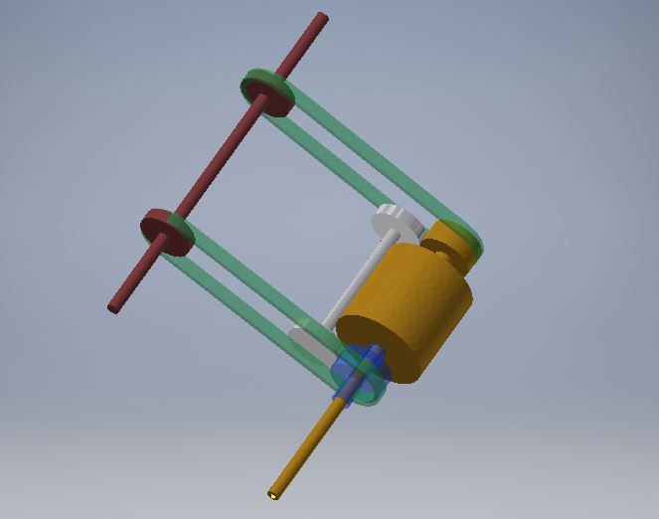
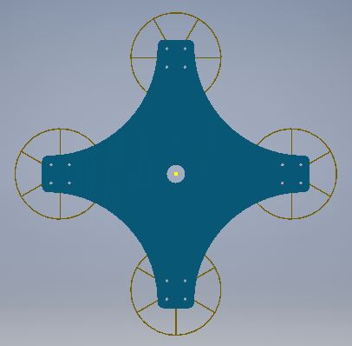
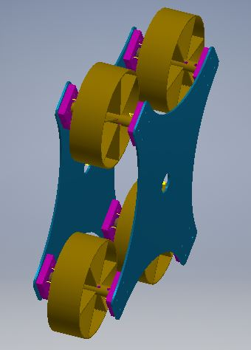
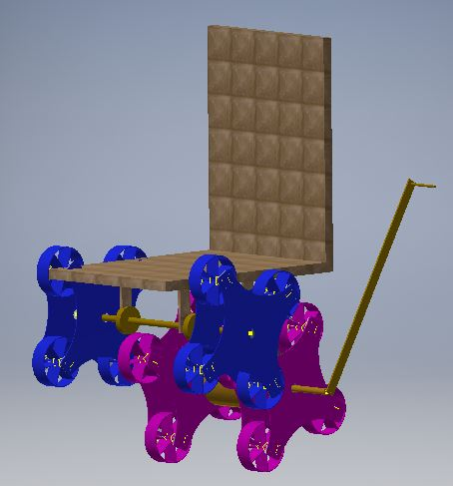
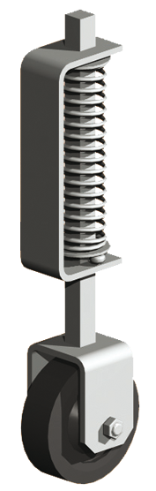
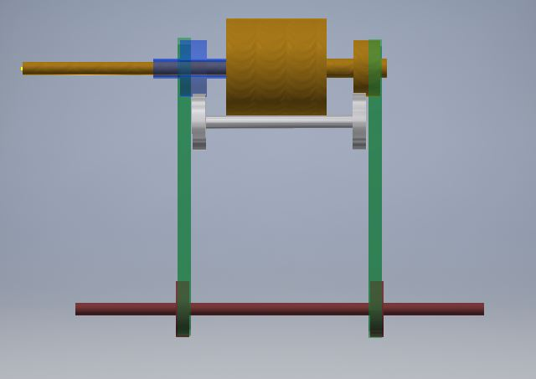
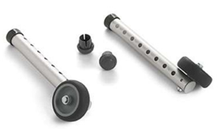
Design components
4 Plus shaped links
Link = 4 wheels + body
Wheels fixed to body
Front and back shafts
Suspended at different heights to keep chair horizontal
2 links mounted on either side
Planetary gear box & coupling gears
Mounted on back shaft and gears for bi-directional output
Belt
Couple back and front shaft
Brake
Switching between stair climbing and ground motion
Adjustable height wheels at the back
Spring loaded wheels at the front

Slide 8
Power train
Planetary gear
Sprocket chain
Handle
Back shaft
Front shaft
Weld and pins
Pins
Back links
Front links

Slide 9
Implementation
Component | Attribute | Product | Prototype | Reason for difference
Planetary Gear | Position | Centered on back shaft | Placed on one end | Avoid gear couplings
Link | Shape | Single body | 2 plates welded | Cost and time constraints
 | Wheel diameter | 15 cm | 10 cm | Cost constraint
 | Arm length | 25 cm | 15 cm | Avoid buckling and welding deflections
Brake | Position | On back shaft | Not present | Availability and implementation complexities
Torque transmission between shafts | Mechanism | Belt | Sprocket chain | Cost constraint
Note : Prototype covers ONLY stair climbing part

Slide 10
Scope of prototype
Capacity ~ 70kg
Self weight ~ 20kg
Tested with ~70kg weight
Step geometry
Width 15-20cm – limited by link length
Height 10-15cm – limited by wheel diameter
2 companions required
Brakes not provided
Uni-directional
Will be explained during demo

Slide 11
Midsem feedback – clarification
Q. Will your chair be inclined when moving on stairs
NO. Links and their shafts are mounted at different heights from chair
Q. Wheels might rotate and fall off a step
NO. Wheels are fixed rigidly to link body
Q. How will you prevent slipping on step edges
We are preventing such kind of landing by using arm length longer than step width
Q. Very high torque need to be applied
We have a gear box and a handle to apply force!! Moreover, that is the maximum torque; not uniform.
Q. How long to ascend?
1 revolution of handle for a step. 4-5 seconds for a revolution

Slide 12
Prototype Budget Allocation
Raw material : ~5200/-
Steel plates
Steel shafts
Nylon wheels
Aluminium plate and blocks
Manufacturing : ~2100/-
Machining
Welding
Miscellaneous : ~1500/-
Nuts and bolts
Sprockets and chain
Bearings

Slide 13
Cost analysis & Market impact
Gear box : 10,000 /-
Wheels & links : 5000 /-
Chair : 4000 /-
Shafts & couplers : 2000/-
Miscellaneous : 4000/-
Total : 25000 /-
Which reduces the cost by 80% when compared to existing products
Customer segment : Disabled and old people in towns and cities living in 1 or more storey buildings
Assuming atleast 1% of the 54 lakh people having disable in moment, we would have atleast 54,000 customer base

Slide 14
Acknowledgements
Kanishka Panda and IITB racing for lending planetary gear
Team #14 for lending raw wooden planks
Central Workshop, IITB for allowing machining and welding

Slide 15
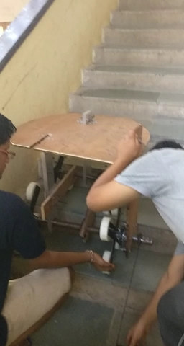
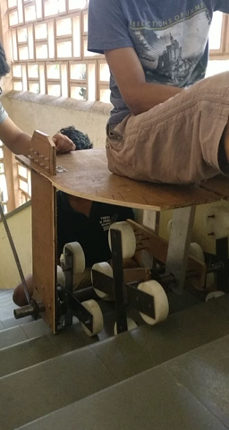
Video

Slide 16
Theoretical analysis*
*Lot of the figures and equations in this section are from our initial report(before midsem) which we compiled as a pdf file. The report is also uploaded in the shared drive

Slide 17
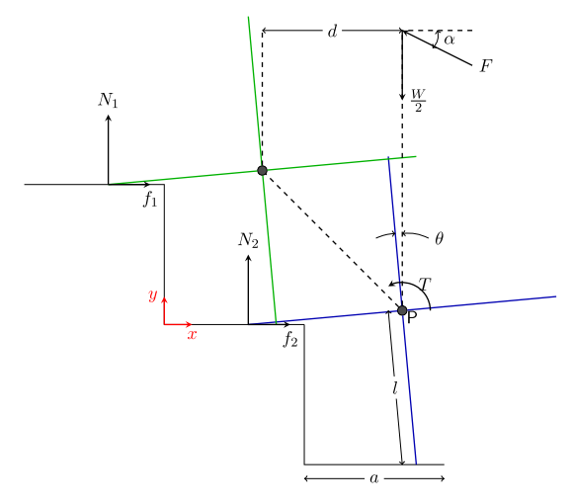
Basic idea
Use a plus shaped link to roll over stairs
Initial idea: each arm is a rod with cylindrical/spherical end
Use two such sets of links on front and back shafts suspended from chair
Two ways to move this mechanism:
Apply only force (F)
Apply only torque (T)
Figure shows FBD of one half mechanism when starting to climb step

Slide 18
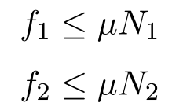
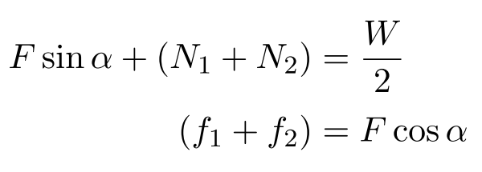
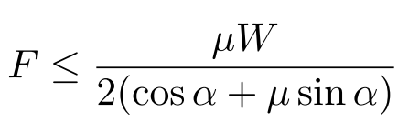
Analysis with only force
For a conservative estimate:
Horizontal and vertical force balance:
Using above equations, we get a conservative estimate of F
Above eqn is for one half of the mechanism. Total force will be twice.

Slide 19
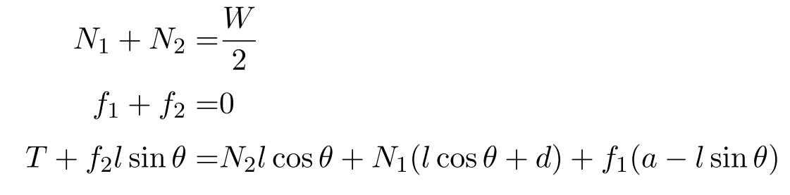
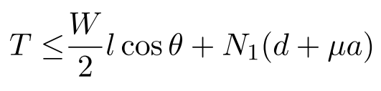
Analysis with only torque
For a conservative estimate, weight is assumed to act along back link center
x, y force and moment equations:
Express 3rd equation completely in terms of N₁, f₁, l, d, W and θ using 1st and 2nd equation
Then using f₁< µN₁ we get
Total torque will be twice.

Slide 20
Rough estimates of force and torque
Assume the following realistic values
W = 150kg
µ = 0.5
l = d = a = 0.2m
α = 40º and θ = 0º
Force comes out to be about 520N and moment about 540 N-m (assuming N₁=0.5*(W/2) in torque equation)
Direct force application not possible
If 1m long handle is used to apply torque, required force is 54kg, not possible for an average human to apply

Slide 21
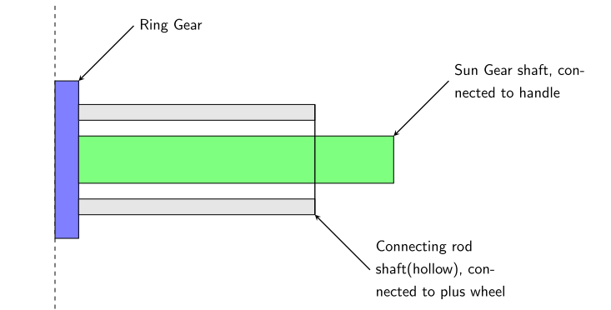
Use of gears
Using gears, torque can be easily magnified
Planetary gear suits this application well
Using gear ratio of about 4, required force on a 1m long handle is about 13kg which is applicable by a human
Following arrangement could be used. More details on power transmission later

Slide 22
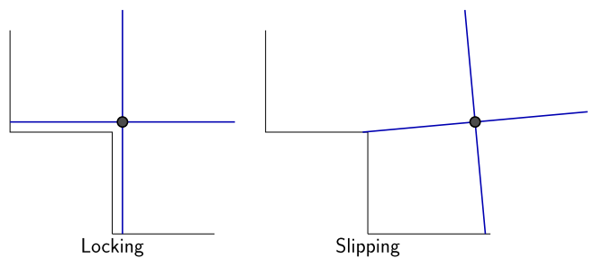
Link shape
There are problems with arm shape being just a rod:
Locking into step corners if arm length is more
Improper landing on next step
The arm shape should automatically accommodate for varying step geometries
There should be enough space for a planetary gear on back shaft

Slide 23
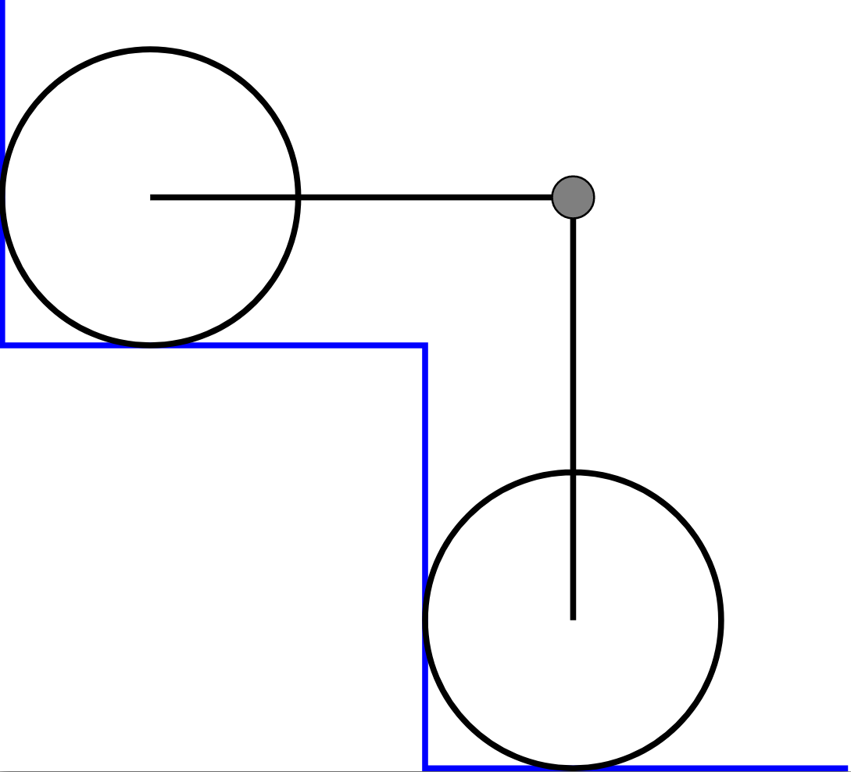
Arm shape design
An arm shape with circular end will prevent locking and slipping
Slipping is prevented since longer arm lengths can be used
Locking is prevented due to presence of circular end
It will also provide space for planetary gear
Space available for planetary gear

Slide 24
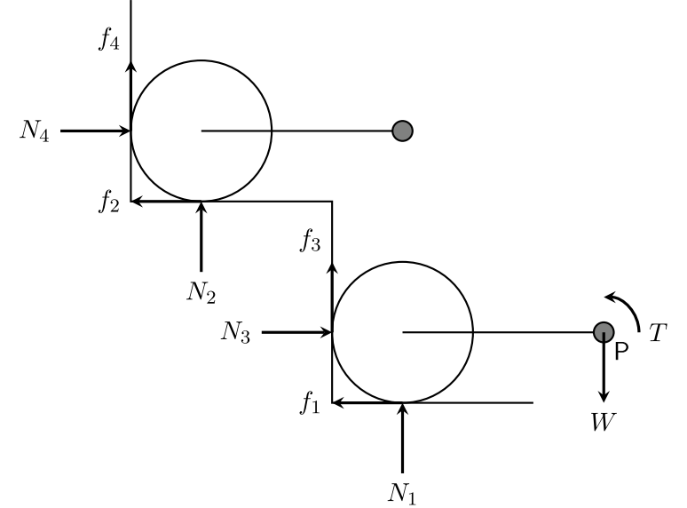
Revised torque calculations
For the new arm shape design, friction can also act on vertical contact walls
Following cases were considered
No circular end in contact with vertical wall
Circular arm end of only back link in contact with vertical wall
Circular arm end of only front link in contact with vertical wall
The figure shows one arm each of front and back link which are of interest to determine torque
Front link center
Back link center

Slide 25
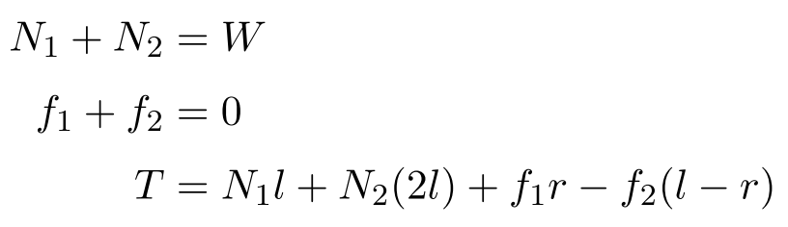
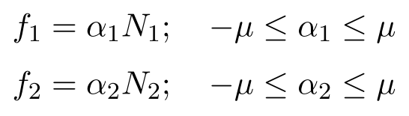
Torque calculations – case 1
The force and moment balance equations are (referring to previous figure)
And the constraints are
A Scilab program (shared in drive) has been written to solve these equations and obtain the maximum value of T
The parameter values are l = 0.15m, r = 0.5*l, µ = 0.5, W = 150kg
Max. torque = 440 N-m

Slide 26
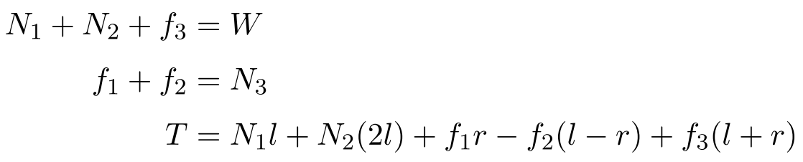
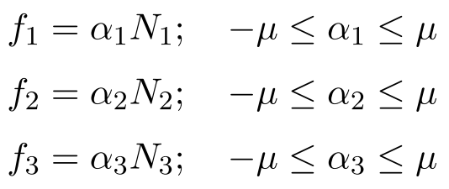
Torque calculations – case 2
For this case, the equations need to be “closed” by using an estimate
Governing equations
Constraints
Closing equation is chosen as N₂=0.5*W which is a reasonable estimate
Max. torque = 385 N-m (from Scilab program)

Slide 27
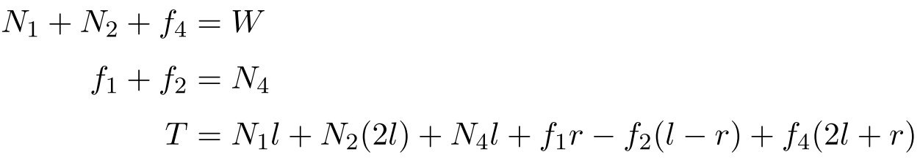
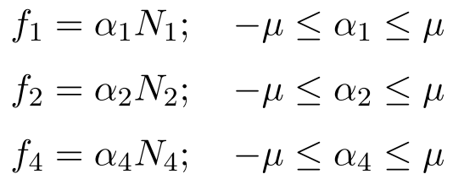
Torque calculations – case 3
Governing equations
Constraints
Closure equation : N₂=0.5*W
Max. torque = 475 N-m (from Scilab program)

Slide 28
Torque calculations – summary
Case with friction acting on both vertical faces is not considered due to complexity involved in getting another closure equation
But since torque in case 1 (no friction from any vertical wall) is more that torque in case 2 (friction from only back vertical wall), it can be assumed that when friction acts on both walls, torque will be less that case 3 (friction from only front vertical wall)
Hence, overall Max. torque is considered to be about 480 N-m

Slide 29
Product overall design

Slide 30

Wheels design
Mechanism for climbing/descending
“Plus” shaped links: four arms with fixed circular wheels at ends
Diameter of the circular wheels - 15cm
Length of the link from end to end - 50cm
Switching between stair climbing and ground motion
Adjustable height wheels at the back
Spring loaded wheels at the front
Source
Source

Slide 31
Torque transmission
User companion rotates the handle of length 50cm
Handle is connected to a shaft mounted on chassis of chair
Torque is transmitted from this shaft to gear input shaft through belt
Gear system(centered on back shaft) amplifies this torque
While ascending the handle is to be rotated clockwise and while descending, anticlockwise
There would be a break to gear output incase of emergencies
Output from gear is coupled to two shafts on which plus links are mounted
Back and front shafts coupled using a belt

Slide 32
Power train
Planetary gear
Sprocket chain
Handle
Back shaft
Front shaft
Weld and pins
Pins
Back links
Front links

Slide 33
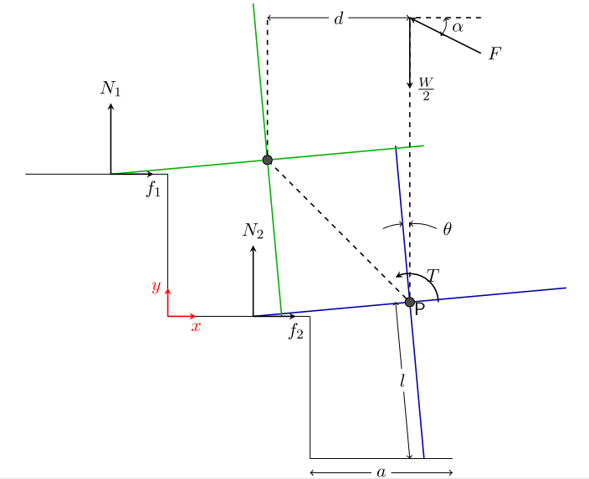
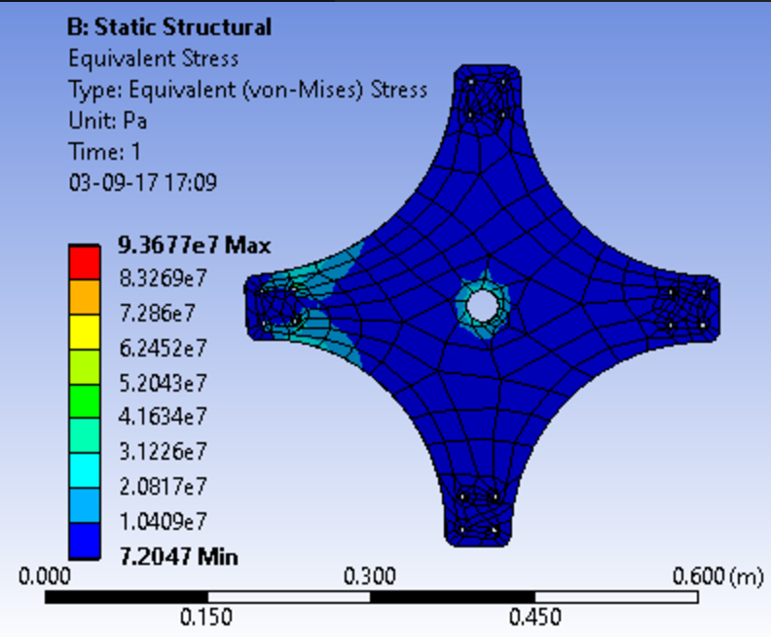
Mechanism Analysis
Input torque is given through a crank
Considering different geometrical positions maximum torque obtained is 470 N-m
Planetary gear is used to reduce the effective torque required
A 4:1 gear ratio would reduce the torque to be applied to about 120 N-m
FBD of the skeleton of the link
Stress analysis of the proposed link shape

Slide 34
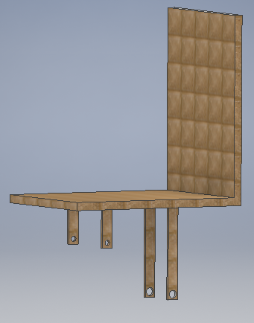
Chassis Design
Front and back shafts are suspended at different heights to keep the chair horizontal while ascending or descending
Bearings will be providing the required support and relative motion between shafts and chassis
2 links are mounted on either side of the front and back shafts

Slide 35
Overall Climbing mechanism
“Plus” shaped links at front and back of chair on either side
All links roll about one of their arm to reach next step
Circular fixed end of arm
Provides space for mounting gear box
Prevents locking against stair corners even for higher arm lengths
Higher arm lengths – no landing on the step edges, makes the mechanism compatible with varying step geometry

Slide 36
Prototype design iterations

Slide 37
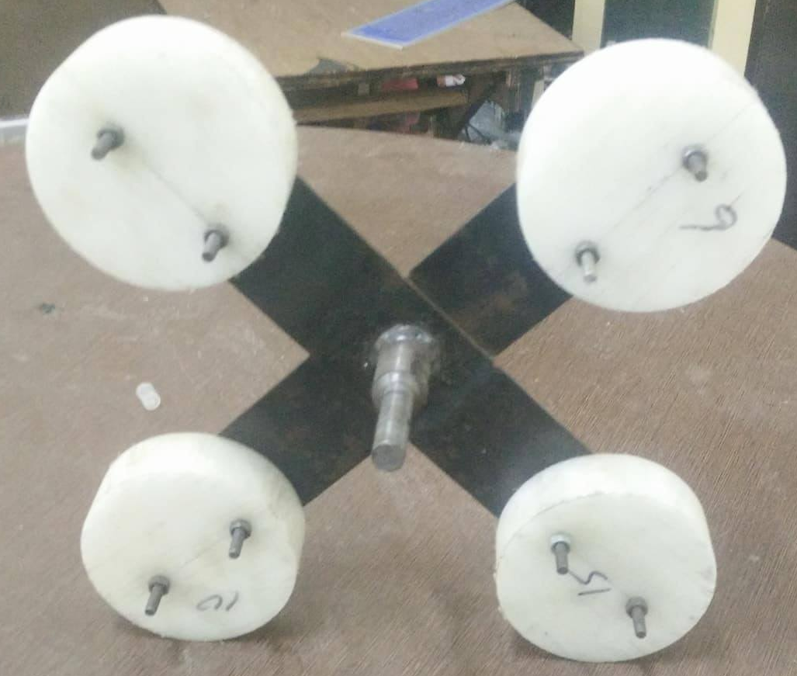
Initial decisions
Link body
Planetary gear was procured from IITB Racing
To avoid complexities, gear would be mounted on one side (not in center)
Link body would be made by welding two plates
Sprocket chain mechanism would be to transmit torque wherever required
Wheels

Slide 38
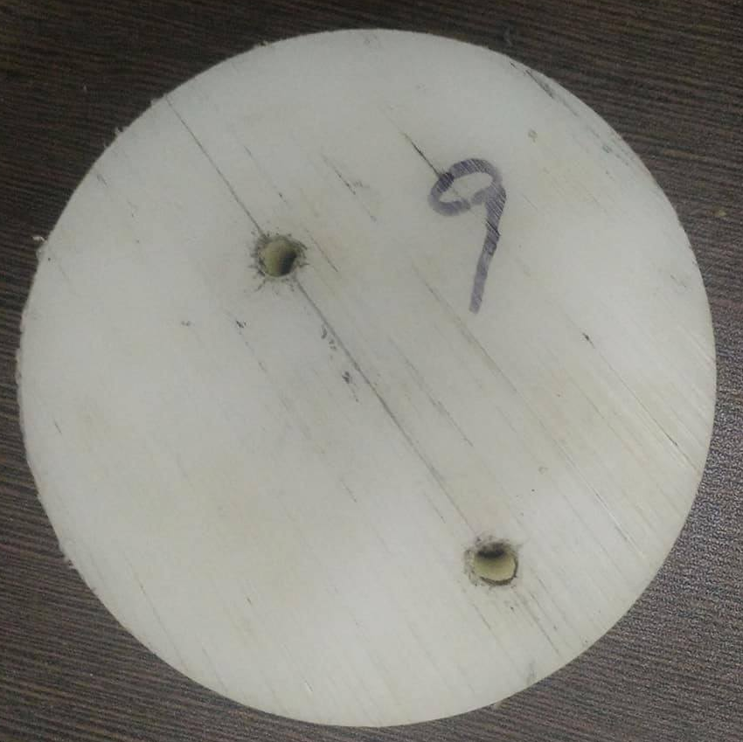
Wheels
Initial idea was to by rubber covered wheels
Make holes in them and bolt to link body
But due to cost constraint, this was not feasible
Nylon wheels of 10 cm dia., 3 cm thick were purchased
Although 15 cm dia. wheels were required (according to design) the cost was too high for 15 cm dia. wheels
Holes (6mm) were made in 16 such wheels and they were bolted to link body

Slide 39
Bearings
3 bearings are required for prototype according to initial design
Front shaft
Back shaft
Upper shaft to which cranking is done. This would be connected to input shaft
Initial idea was to use 35 mm I.D. bearings since sprocket (previously decided) I.D. was also 35 mm
But 25 mm I.D. bearings were used for the following reasons
O.D. of 35 mm bearing was 72 mm which is too big. The block size for holding this bearing would be high and hence cost would go up
The cost for 35 mm bearing was also significantly high than what we allotted

Slide 40
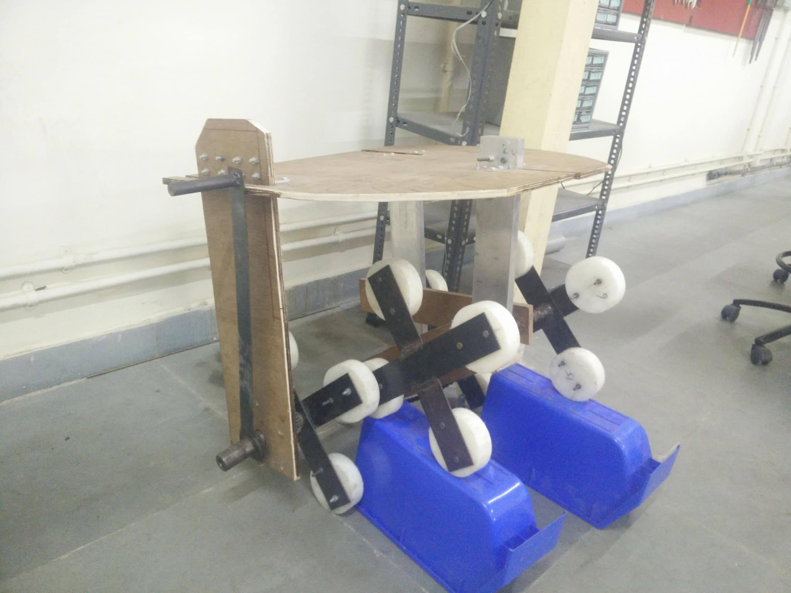
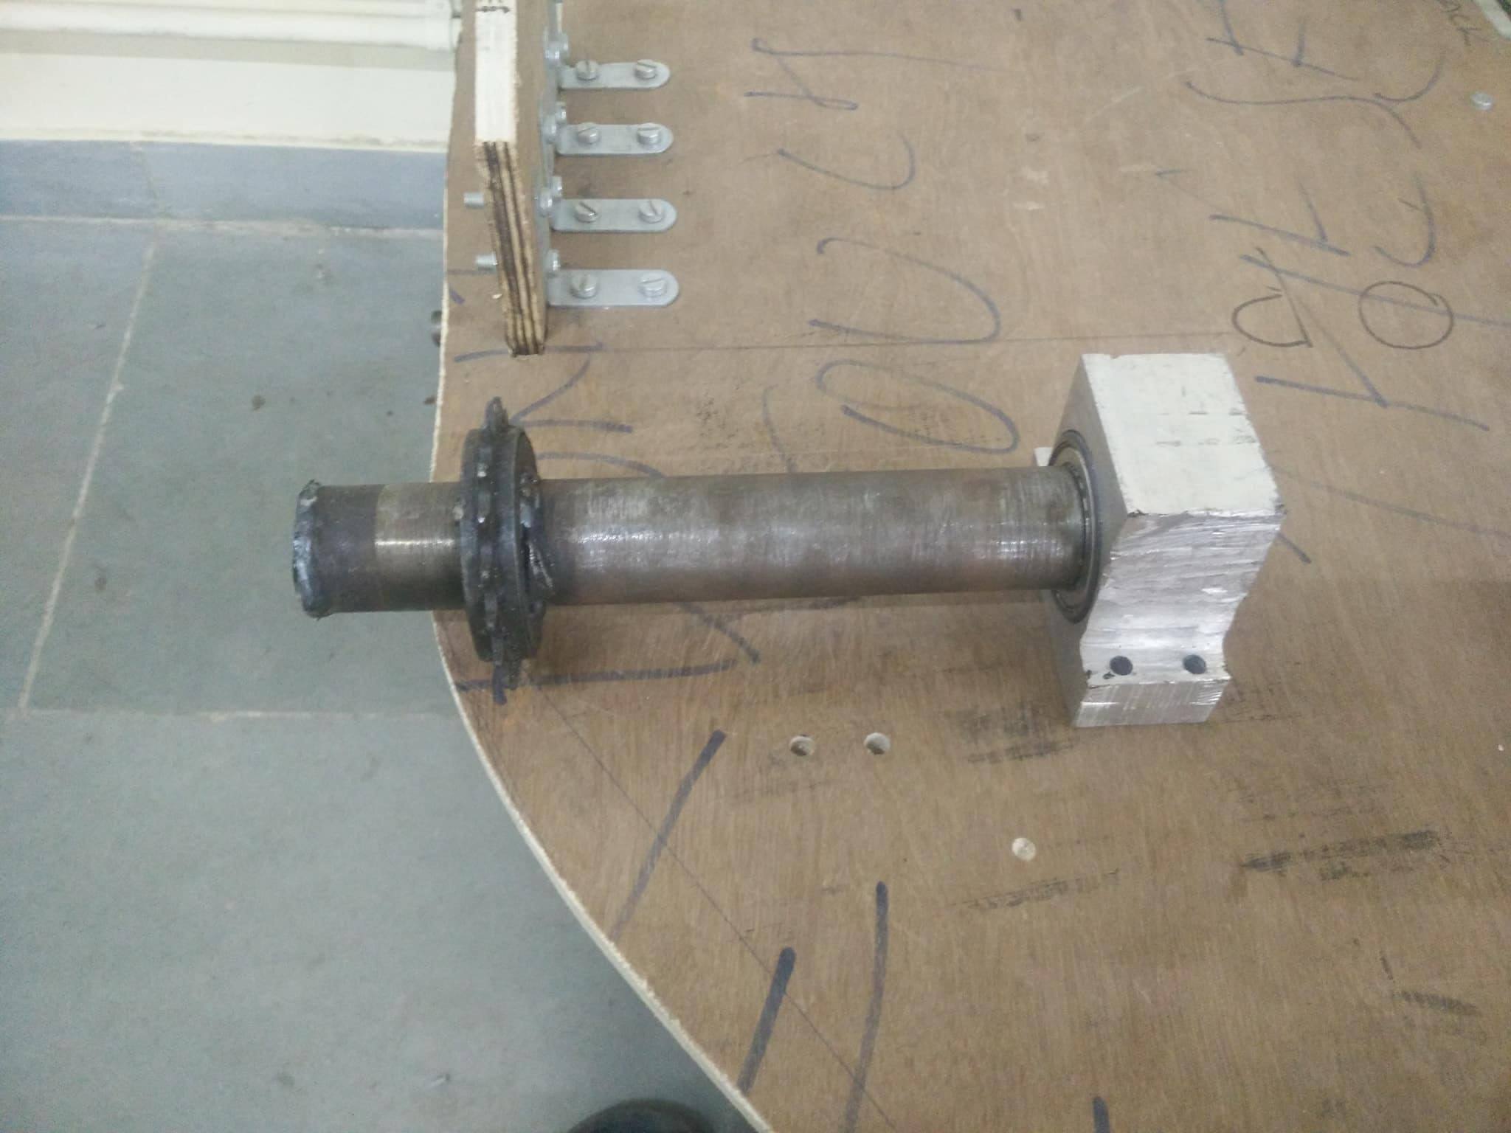
Bearing blocks
Back shaft bearing block
3 bearing blocks are required according to initial design
Front shaft bearing
Back shaft bearing
Upper shaft bearing
The bearing block for front and back shaft would be of different lengths and would be suspended from chassis
Upper shaft bearing would be bolted on the chassis
Upper shaft bearing block
Front shaft bearing block

Slide 41
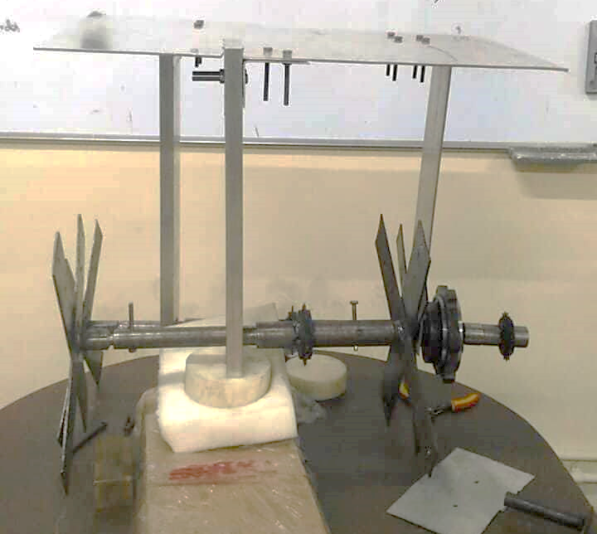
Chassis
Al chassis in initial design
Initially thought of using 3 mm Al plate as chassis
Another bent 3 mm Al plate on which the gear would be fixed would be bolted to chassis
Two Al aluminium blocks of different length for supporting bearings are connected to chassis
Bent plate to hold gear
Planetary gear

Slide 42
Front and back shaft
One end of back shaft would be mated with gear output
From that end, 2 steps would be provided for the following purposes
To weld sprocket
To press fit bearing
Front shaft would be a single stepped shaft to accommodate sprocket and bearing
Both the shafts were made hollow wherever possible, by how much ever possible to reduce weight

Slide 43
Assembly – making links
Link body
Link = link body + 4 wheels
Link body was made by welding two plates
Matching holes were made in link body and wheels and the wheels were bolted to link body
Wheels
Auxiliary shaft

Slide 44
Assembly – links to shafts
Front shaft
On both sides, links were welded to a small stepped shaft – auxiliary shaft
One end of auxiliary shaft goes into front shaft, other end welded to link
Front shaft and two such auxiliary shafts were connected by making through holes perpendicular to axis and bolting along the hole
Back shaft
On the side not having gear, an auxiliary shaft is used (similar to front shaft)
On the side having gear, auxiliary shaft couldn’t be used
A hole of dimension equal to shaft dia. was made on the link
The link was then welded to back shaft directly

Slide 45
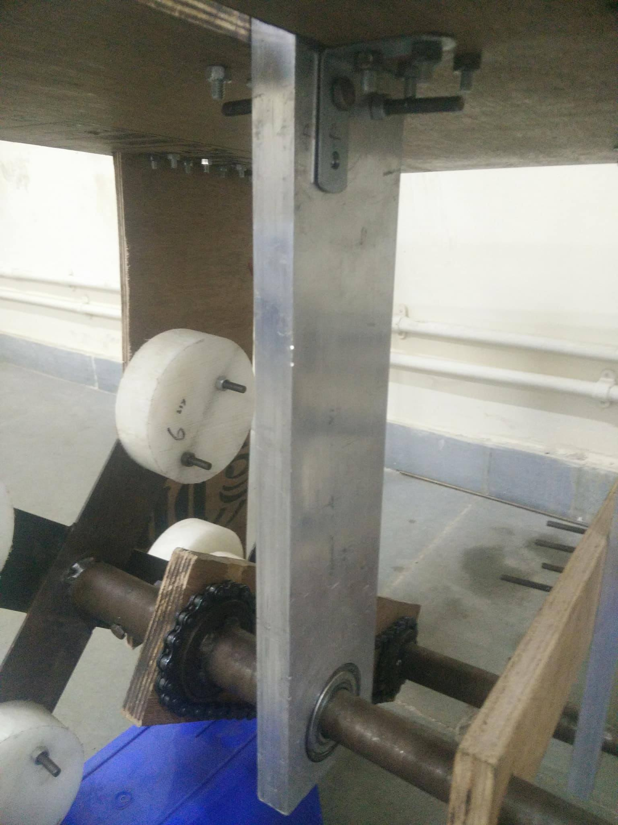
Assembly – others
L-clamps
Chassis
Front and back bearing blocks were bolted to chassis using L-clamps
Bearing block of upper shaft was shaped so that it could be directly bolted to chassis by making through holes
Gear was connected to chassis by using a large bent Al plate
On end fixed to chassis
Other end bolted to ring gear of gear box
Chains were used to connect sprockets on front shaft to back shaft and upper shaft to input shaft

Slide 46
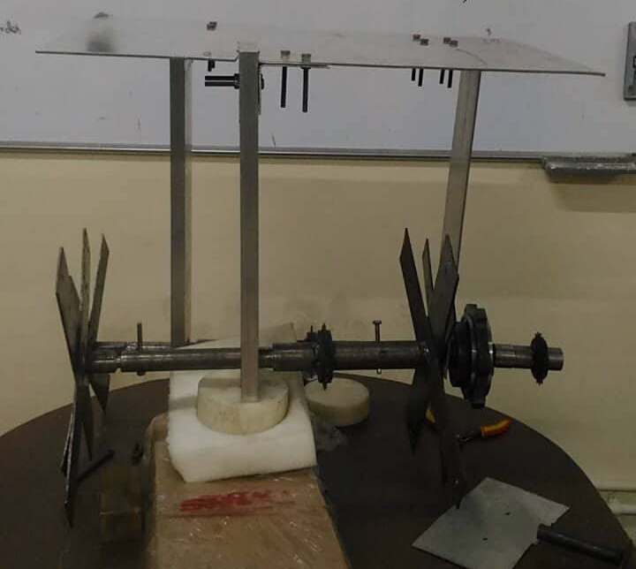
Issues in initial prototype
There was too much bending happening in chassis
Joints on the chassis were not rigid enough which lead to play between front and back shafts
There was play in planetary gear mounting
Chain was not intact with sprockets due to above reasons

Slide 47
Changes to initial design
Wood was used to replace Al for chassis
A wooden plank was used to fix the ring gear of gear box. Other end of the plank was fixed to chassis through L-clamps
The play in prototype was significantly reduced
But the chassis was not strong enough to take the force of chain connecting input shaft and the upper shaft
We decided to eliminate use of upper shaft by giving input directly through the input shaft of the gear

Slide 48
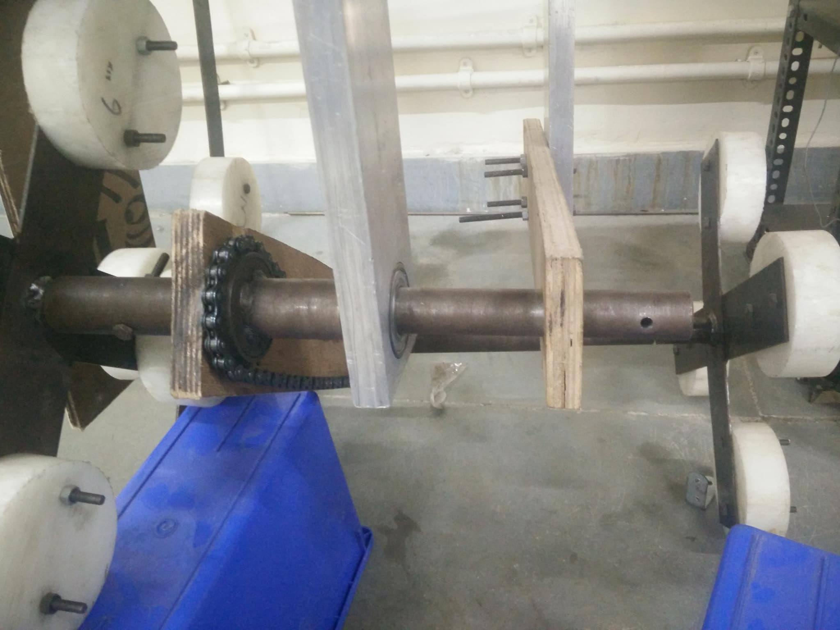
Plank to fix ring gear
Wooden chassis
Front shaft
Front shaft bearing block
Back shaft bearing block
Input handle
Wooden reinforcements between front and back shaft

Slide 49
Prototype part details

Slide 50
Parts
MS plates
Nylon wheels
Bearings
Chassis= Wooden plank+Al blocks
Planetary Gear
Sprockets and chain
Crank= MS plate and a handle
Shafts-Front and back

Slide 51
Wheels
MS Plates
8 MS plates of identical dimensions were procured for making the links
Dimension = 40 mm X 6 mm
Cost = Rs 300
16 Nylon wheels of identical dimensions were procured for making the links
Dimension : Diameter=10 cm Thickness = 3 cm
Cost = Rs 2336

Slide 52
Chassis – wooden plank +Al Blocks
Bearings
2 bearings of identical dimensions were used
Dimension : OD= 5.2 cm , ID =2.5 cm
Cost = Rs 729
Al plate was used initially but was replaced by wood
Dimensions : 40cm*50cm*.3cm, Cost= Rs 300
2 Al blocks of dimensions : 60cm*15cm*3cm
Cost = Rs 1600

Slide 53
Front & Back shafts
Sprockets & Chains
3 Sprockets and 1 chain were used finally
Cost : Rs 300
2 Mild steel rods of radius 3.5cm and length 50cm
Raw material and Machining cost: Rs 2000
Crank
Mild steel plate of dimensions: 60cm*3cm*.3cm
Raw material and Welding cost: Rs 100

